Slide 1
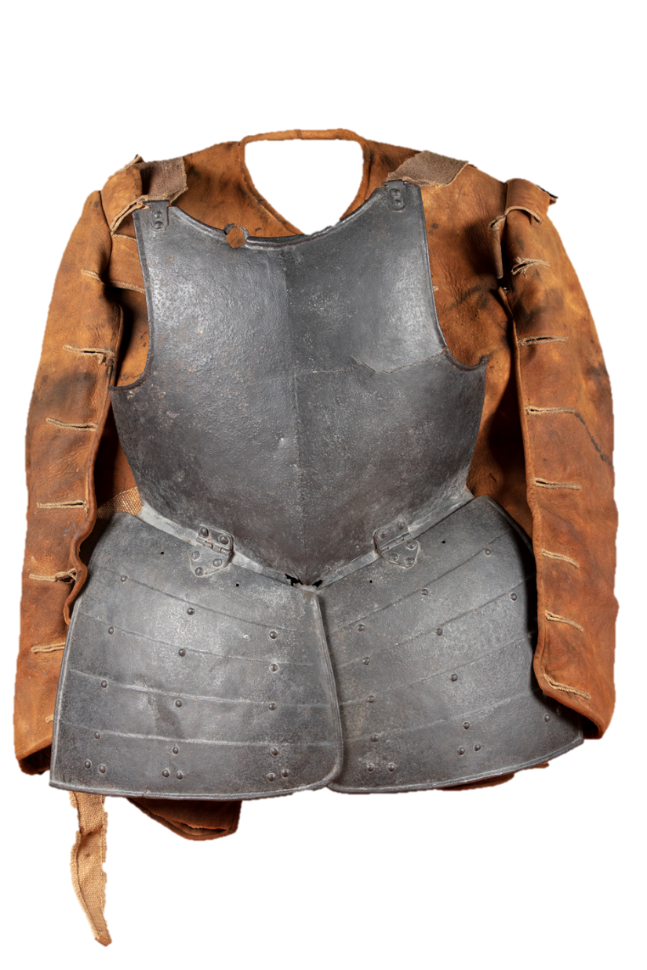
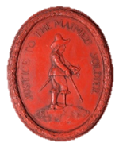
Fight a battle
Find a battlefield
Solve a mystery
Meet some soldiers
Soldiers

Slide 2
Fight a Battle
in
The British
Civil Wars!
Soldiers

Slide 3
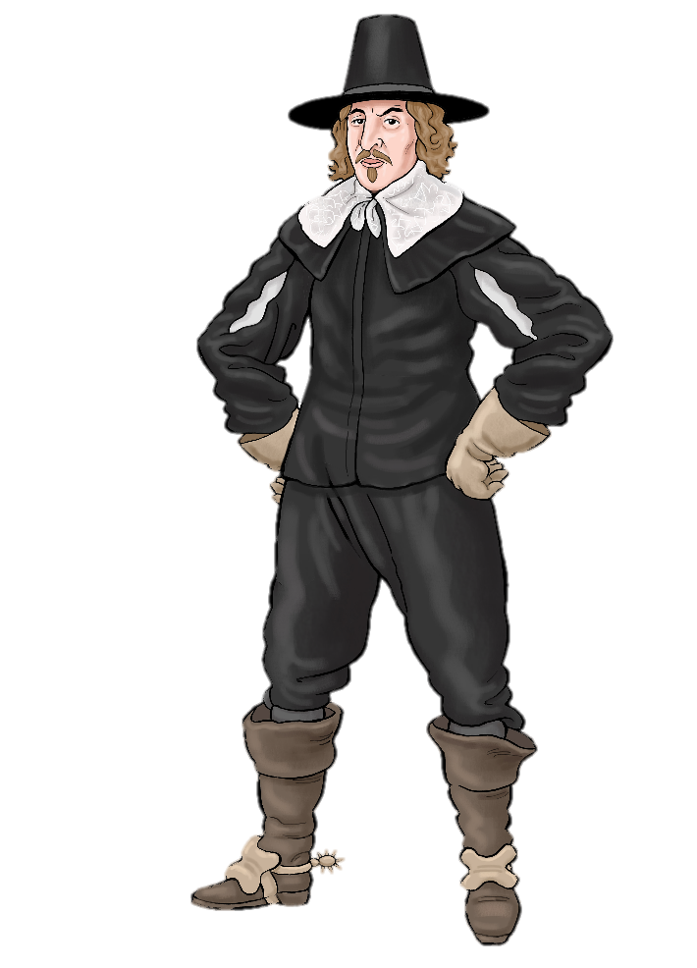
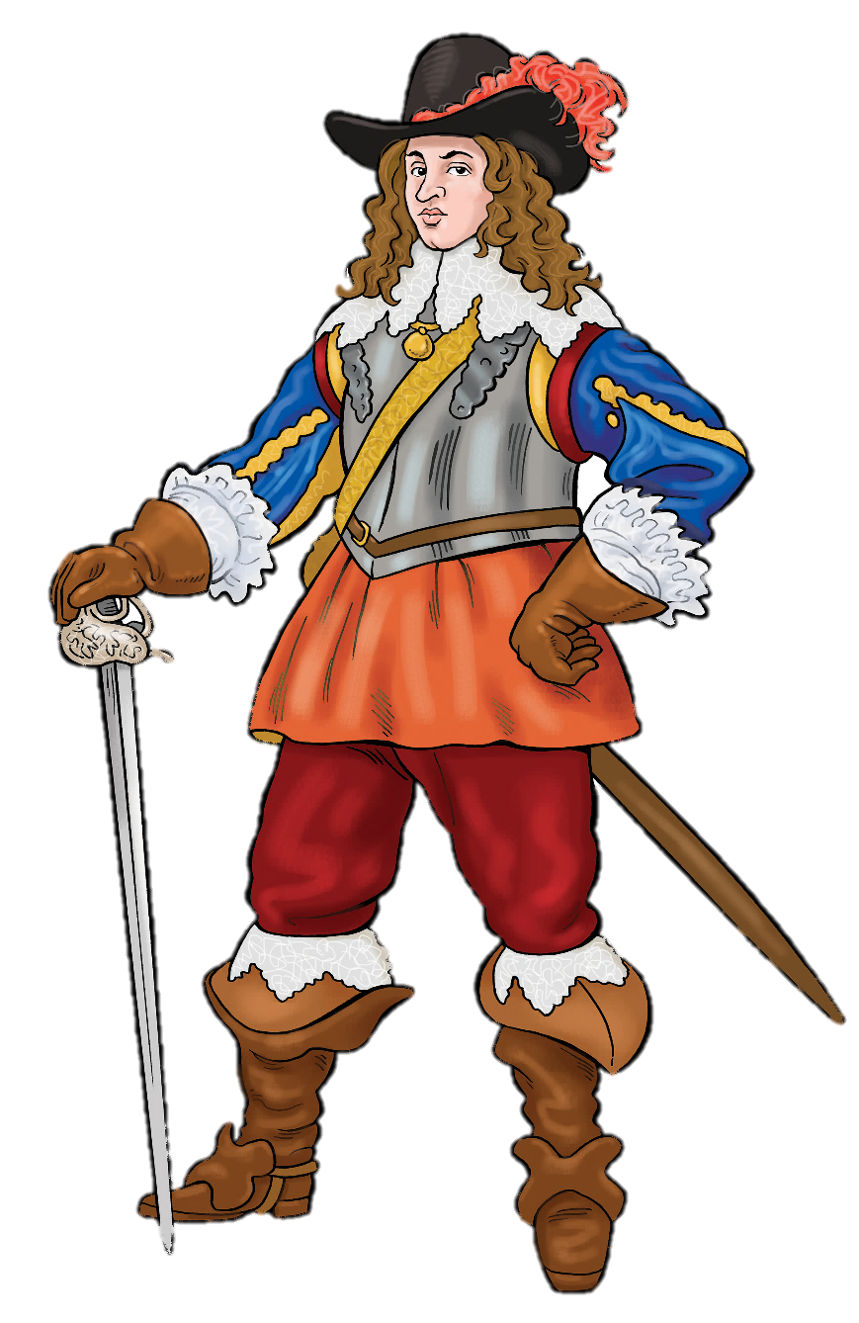
It is 1642.
Civil war has broken out!
King Charles I is at war with Parliament.
Every town and city must choose a side.

Slide 4
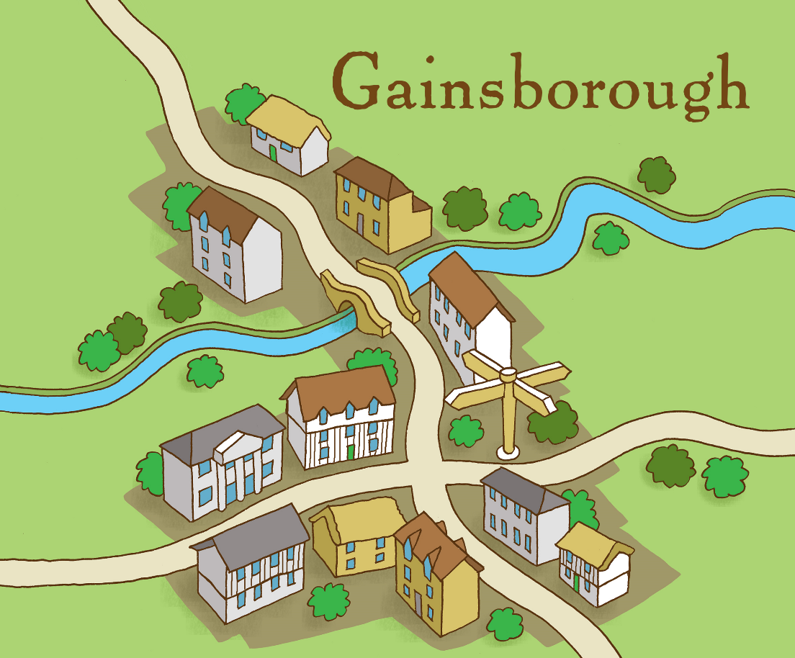
The small market town of Gainsborough is trying not to take sides.
But Gainsborough is an important place. Both sides want to control it.
Can you see why?

Slide 5
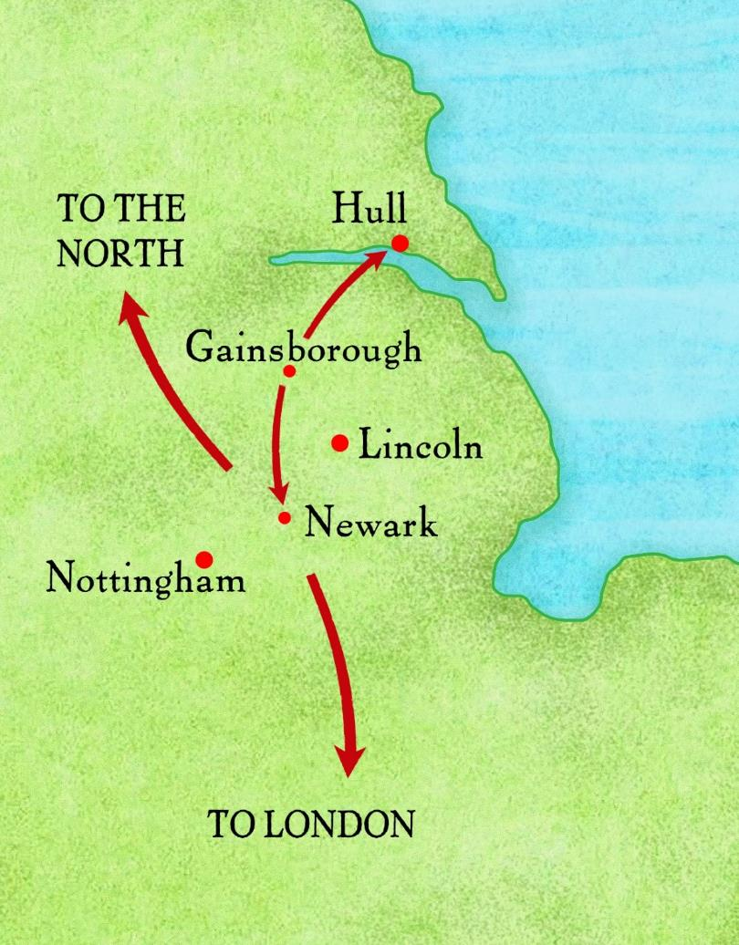
Gainsborough’s river and crossroads connect it with important places.

Slide 6
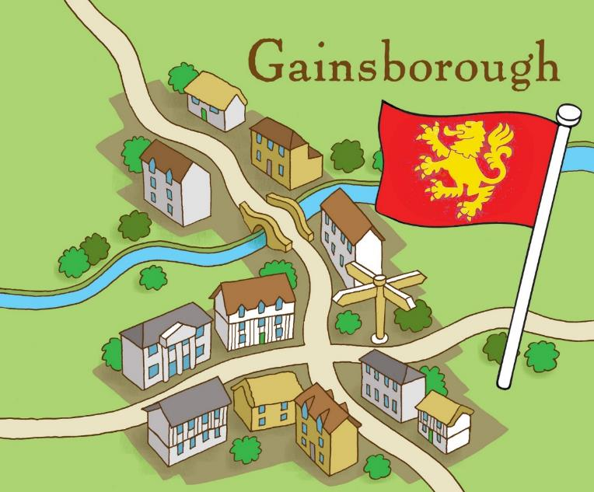
March 1643: Gainsborough becomes Royalist!
Royalist soldiers from Newark take control of the town.
The Royalists are attacking our soldiers. They are even stealing our gunpowder!
Something must be done!

Slide 7
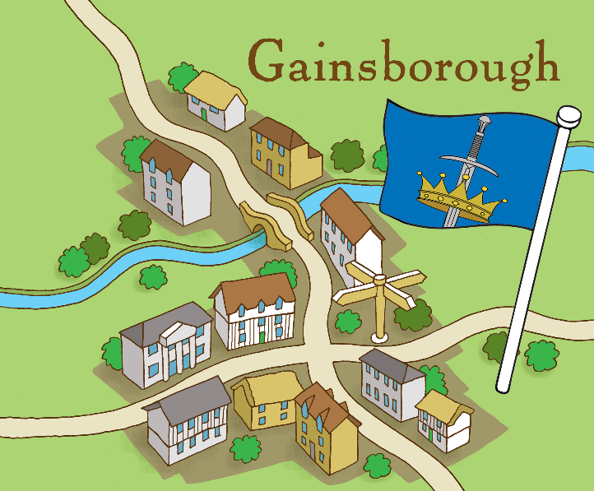
July 1643 : Gainsborough becomes Parliamentarian!
Parliament sends Lord Willoughby to capture Gainsborough
We captured the Earl of Kingston, the Royalist governor of Gainsborough, and sailed him down the river to Hull. On the way, he was cut in half by a cannonball, fired by his own side!
Click here to listen

Slide 8
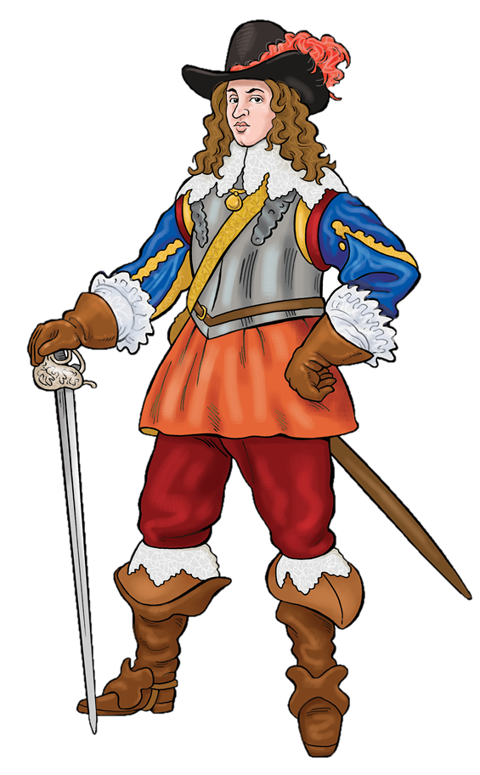
July 1643 The Royalists want Gainsborough back!
They send Charles Cavendish to surround Gainsborough and force it to surrender.

Slide 9
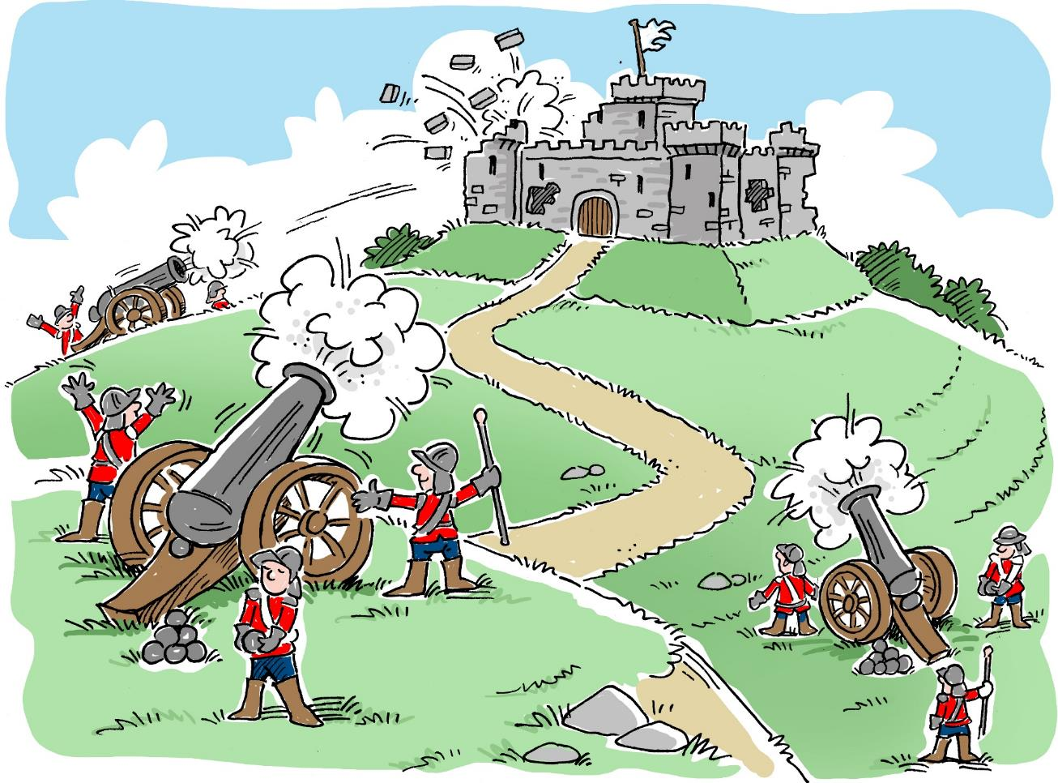
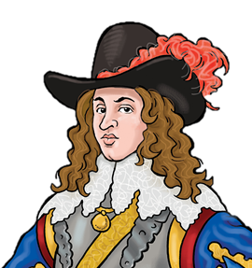
This is called a
SIEGE

Slide 10
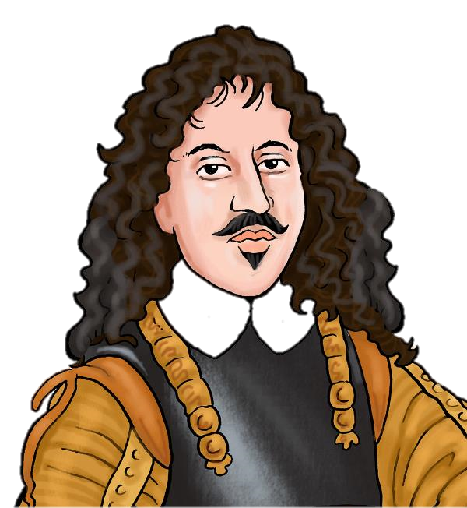
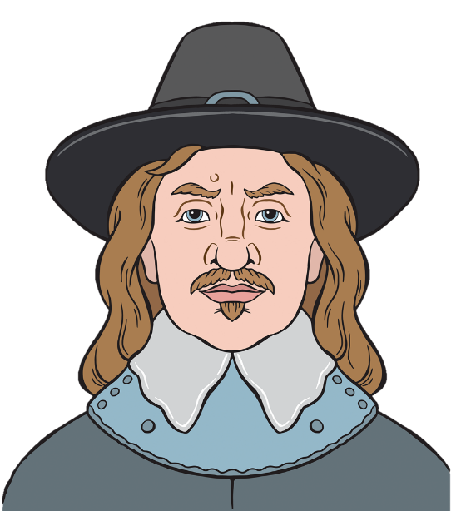
Parliament send an army commanded by John Meldrum and Oliver Cromwell to break the siege and hold the town.

Slide 11
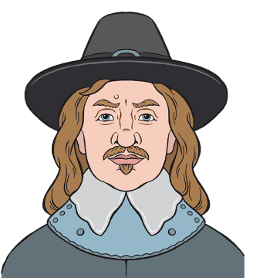
It’s time to fight the Battle of Gainsborough!
1.
Take Sides:
Divide into 5 groups
3 groups will fight for Parliament and 2 groups will fight for the King.
Each Group is an officer in the battle.
2.
Fight
Stop at the decision points. Discuss what should happen next. Report back on your advice.
Decision group: Listen to the advice then make your decision!
3.
Click
the blue squares to find out what happens next

Slide 12
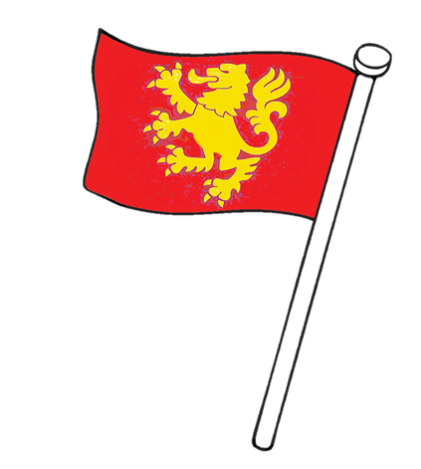
Groups 1 and 2 : You are
Charles Cavendish
23 years old
A dashing royalist commander
Fought bravely at The Battle of Edge-Hill
(the first big battle of the war)
General in command of the King’s forces in Nottinghamshire and Lincolnshire
Royalist

Slide 13
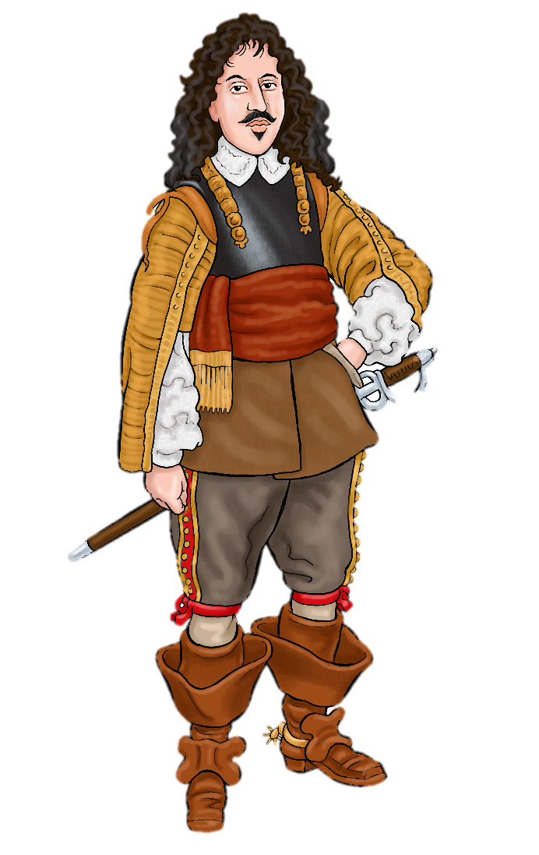
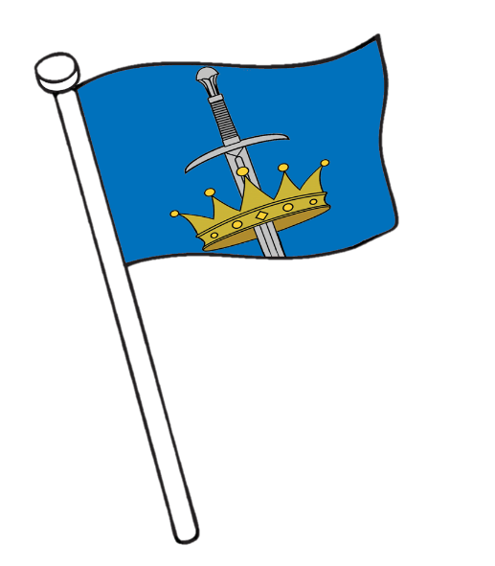
Group 3 : You are
Sir John Meldrum
Commander of the Parliamentarian forces fighting in this battle
Scottish
Very experienced,
A professional soldier
.
Parliamentarian

Slide 14
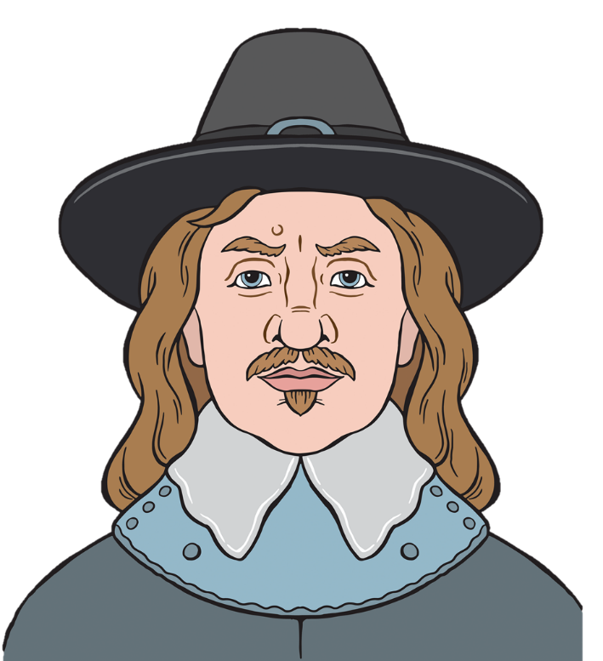
Groups 4 and 5: You are
Oliver Cromwell
43 years old
Had never ever fought a battle before this war.
Became a captain only last year
Has won some small battles
Colonel of several cavalry regiments
Parliamentarian

Slide 15
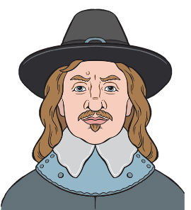
Before we start…..
1. Can you guess what will happen in this battle?
One of these men will die. Which one?
One of these men will become a superstar soldier? Which one?
One of these sides will win control of Gainsborough. Which one?
2. Can you remember how to win a civil war battle?

Slide 16
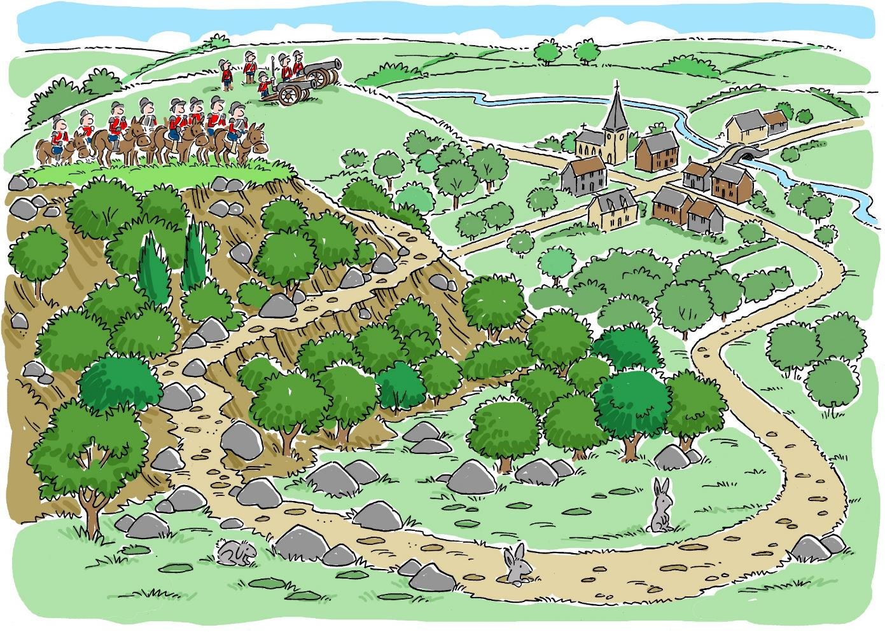
Look at the terrain.
What might be difficult
about fighting this battle?

Slide 17
It is time to fight a battle to take control of Gainsborough. Cavendish, where will you place your army? 1. On the lower ground? 2. On top of the hill?
Decision Point: group 1

Slide 18
1. Place your army on the lower ground If you do this you will miss an opportunity to take the advantage! Parliament will win and Gainsborough will fall into Parliamentarian control.. .. better to…

Slide 19
2. Place your army up on top of the hill. Excellent decision! From here you can see the road coming into Gainsborough and you are protected by the steep slope underneath you.

Slide 20
The enemy is on top of a steep hill. There is a rabbit warren all over the slope. This is dangerous and tiring for horses. Do you.. 1. retreat ? 2. charge uphill to fight?
Decision Point: group 3

Slide 21
1. Retreat .. The Royalists will hold Gainsborough. You will be called to explain your cowardice in Parliament. You might be sacked or even put on trial! Much better to…

Slide 22
2. Charge uphill to fight A brave decision! (This is what Meldrum and Cromwell do..) Take care! You must reach the top quickly without losing any horses or men.

Slide 23
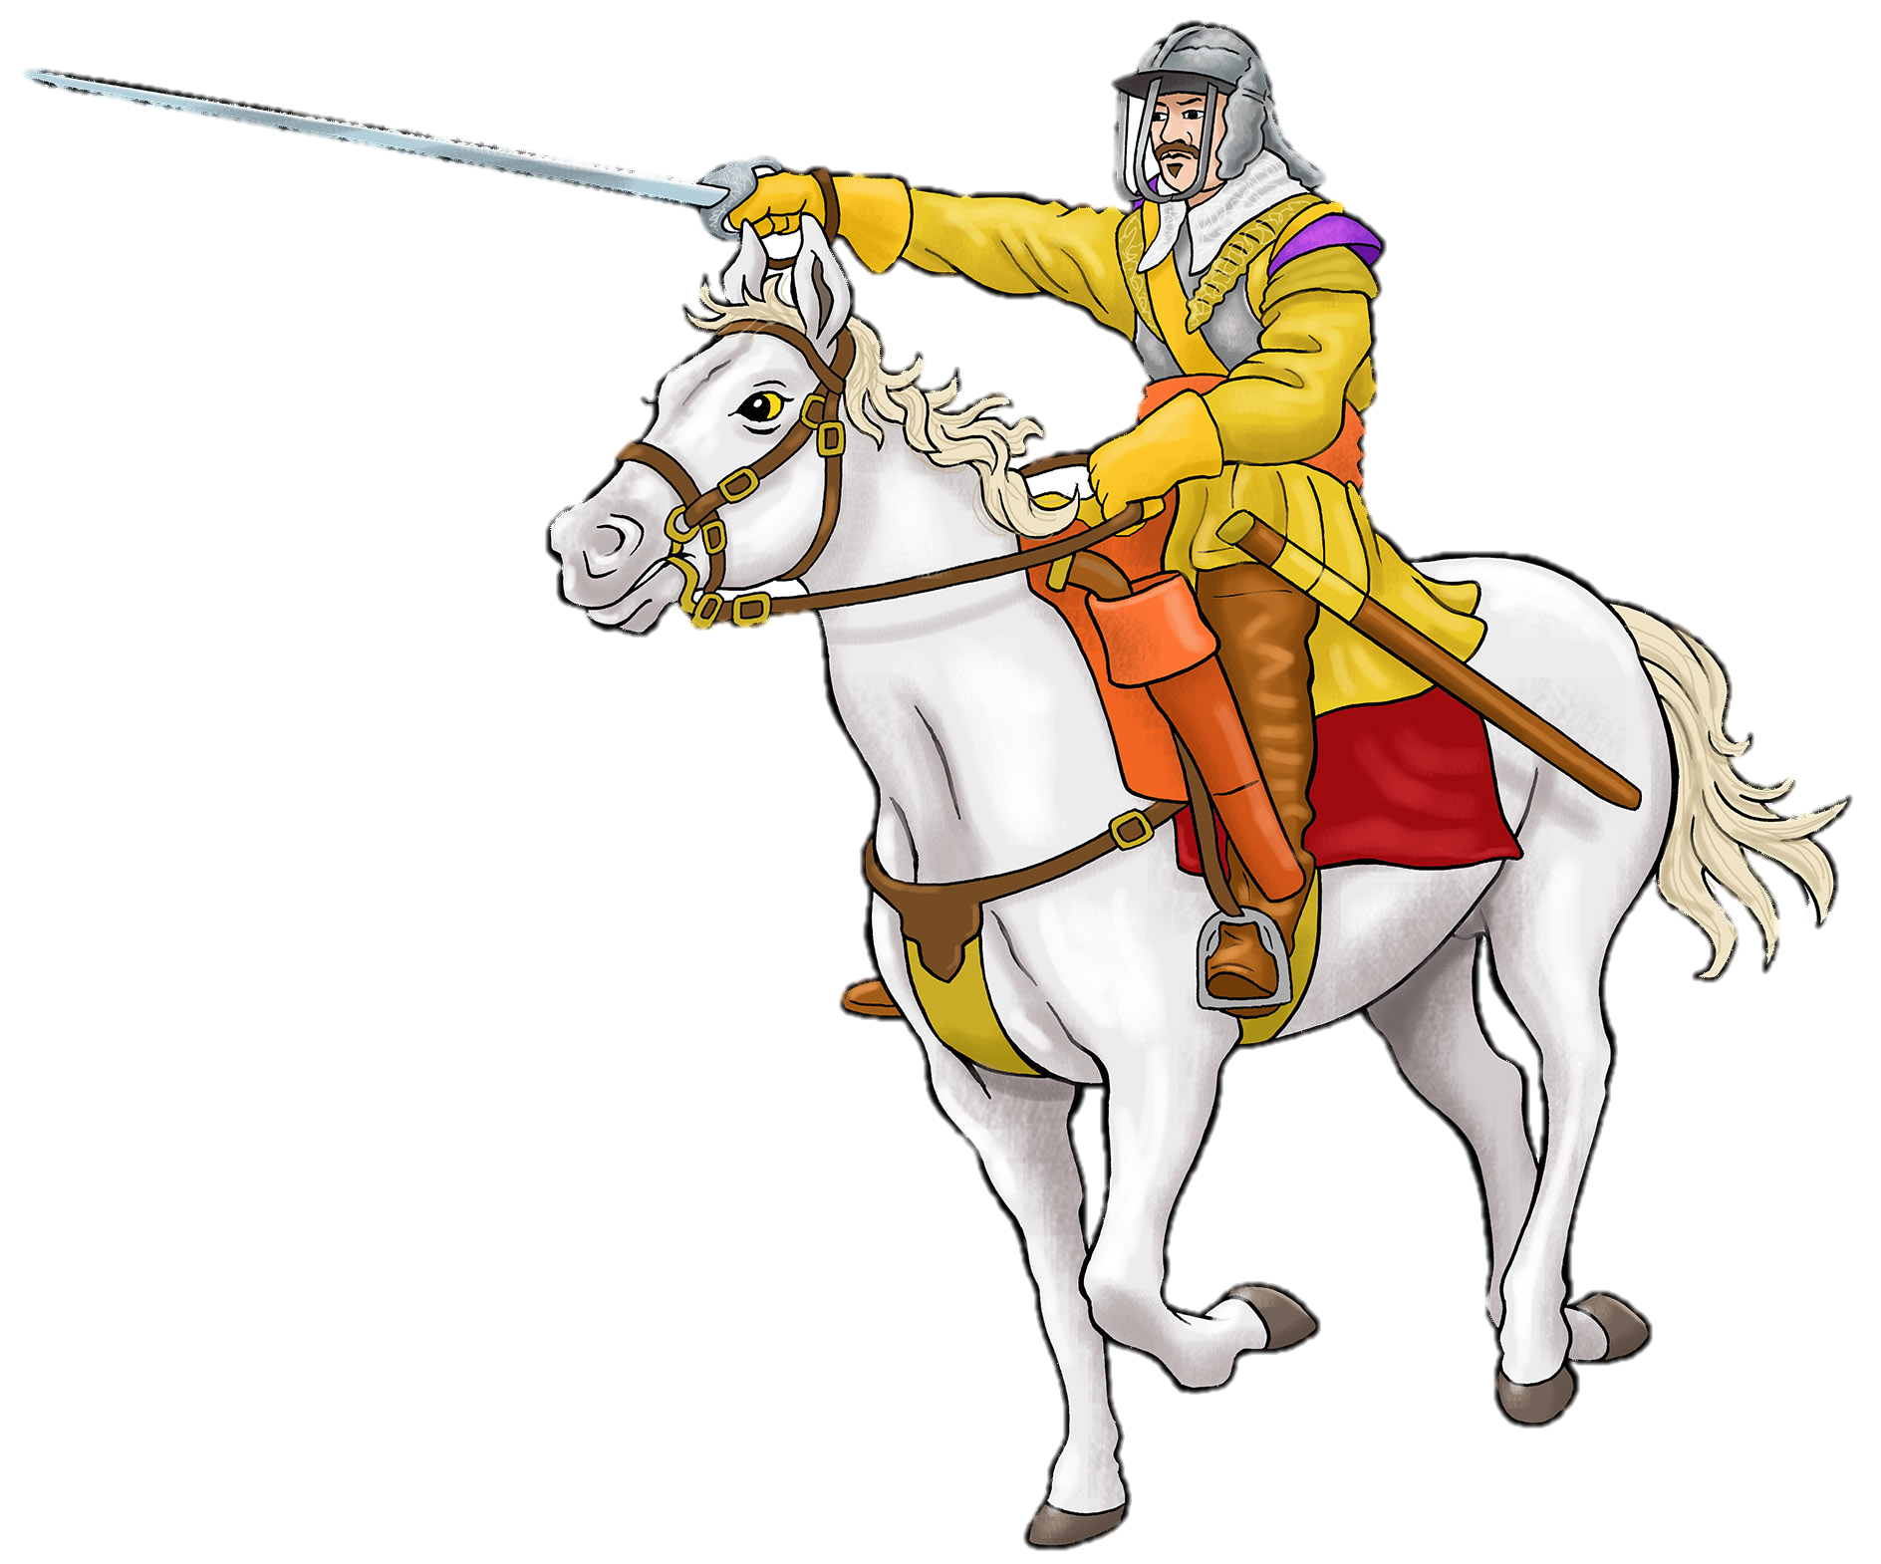
Meldrum and Cromwell charge up hill, firing their weapons. This is difficult, especially under enemy fire. There are no paths, only tracks, and lots of rabbit holes that might trip the horses.

Slide 24
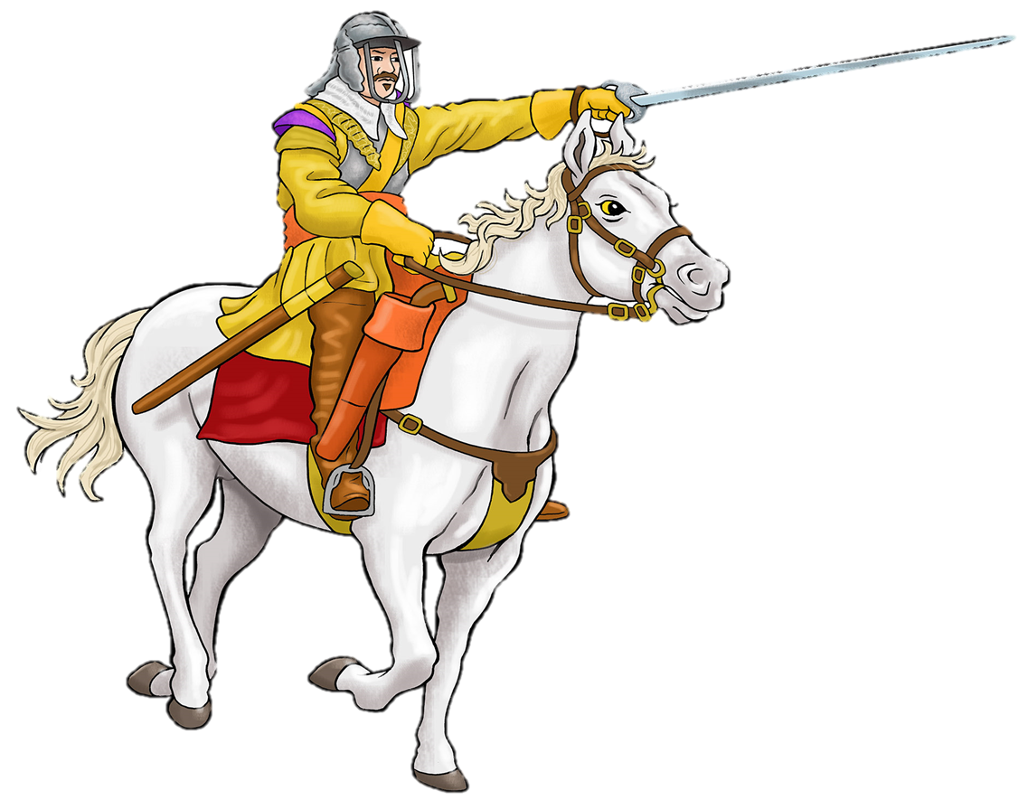
At the top the enemy is very close, only a musket shot away (about 90m)

Slide 25
Cavendish, do you 1. order all your soldiers to fight? or 2. hold a regiment back in reserve for later?
Decision Point: group 2

Slide 26
1. Order all your soldiers to fight. You might win this way, with a huge shock to the enemy But.. if you start to struggle, who will come to your aid? Better to…

Slide 27
2. Hold a regiment back in reserve for later. Excellent plan! This is exactly what Cavendish does...

Slide 28
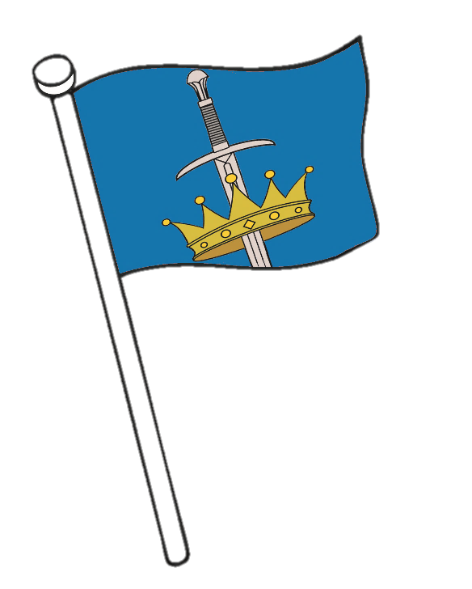
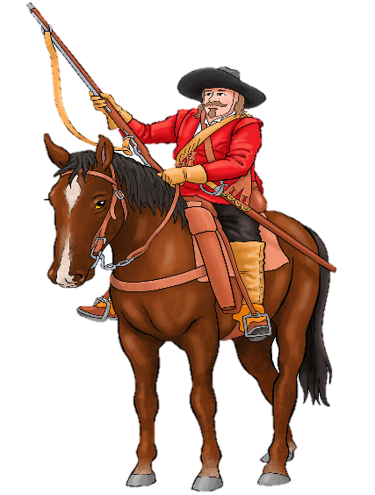
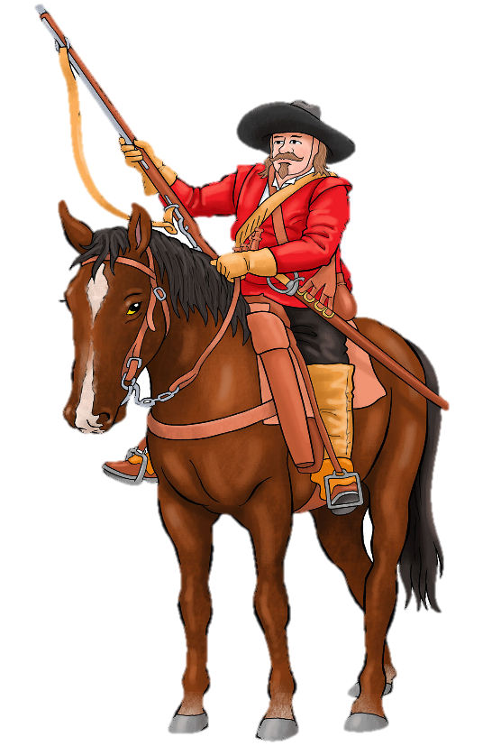
Cavendish charges first to take the advantage. Cromwell charges to meet him. There is a huge fight at close range. Both sides fight with pistols, muskets and swords.

Slide 29
After a while the Royalists seem to tire. The Parliamentarians break through royalist lines. The Royalists are scattered. They start to run away!

Slide 30
Cromwell, what is your next move? Do you .. 1. chase after the enemy to see them off the battlefield? 2. hold back your troops and to fight the royalist reserves?
Decision Point: group 4

Slide 31
1. Chase the enemy off the battlefield? If you do this you will lose the battle! The royalist reserves will have the advantage on the hill. Much better to…

Slide 32
2. Hold back your troops and fight. Excellent idea! This is what Cromwell does. This shows what a brilliant military leader he is. His well trained soldiers stay to fight and attack Cavendish’s reserves.

Slide 33
Cromwell, how can you win this battle now? 1. Force the enemy down the slope? 2. Keep fighting on top of the hill
Decision Point: group 5

Slide 34
2. Keep fighting on top of the hill This might result in a draw. You need to do something more devastating to the enemy. Much better to..

Slide 35
1. Force the enemy down the slope Good idea! This is what Cromwell does. Now you have the advantage. You push the enemy down the hill to the bog at the bottom and here you knock Cavendish off his horse. He is killed with a sword thrust to the chest.

Slide 36
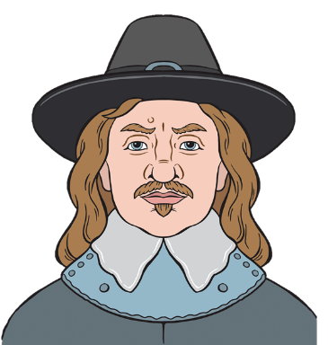
The Parliamentarians have won! They didn’t start with an advantage. What did they do that helped them win?

Slide 37
Top Tactics
Meldrum and Cromwell made the brave decision to charge uphill, over difficult terrain.
Cromwell held his soldiers back from chasing the enemy and stayed to fight.
He pressed home his advantage and pushed the enemy down the hill.
These decisions made Cromwell into a superstar (he claimed credit for all of them!)

Slide 38
The brave and promising Cavendish has died. The Parliamentarians have broken the siege and held onto Gainsborough.. ..but not for long…

Slide 39
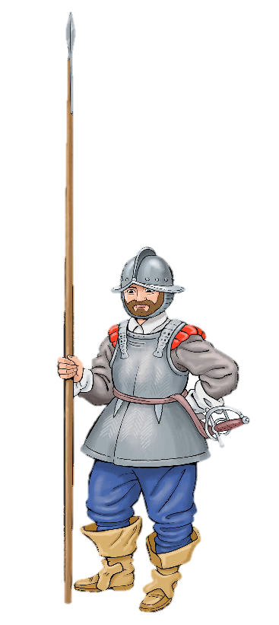
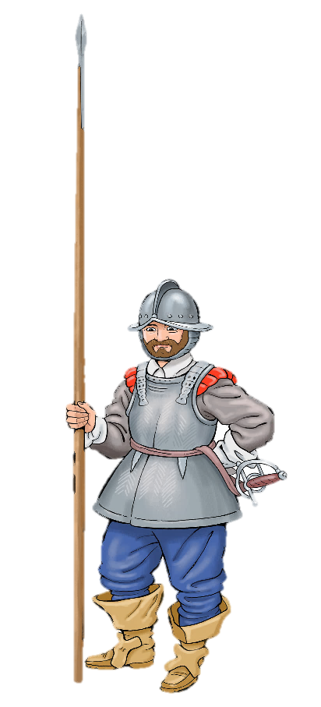
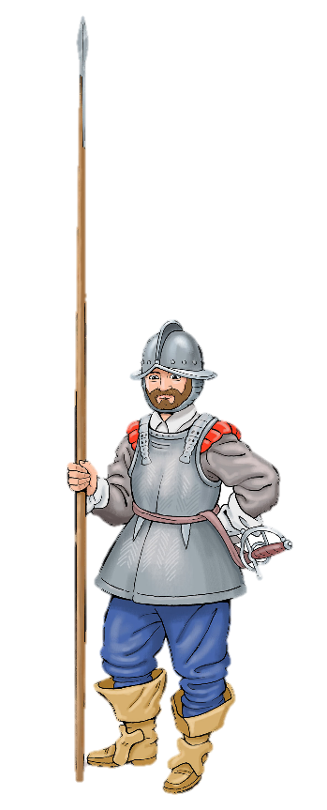
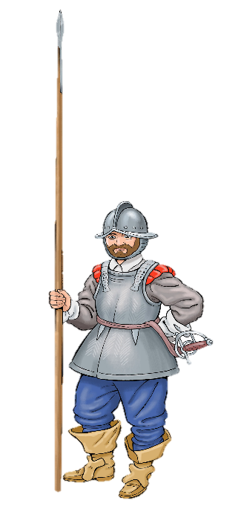
Cromwell notices something on the horizon. ….. The royalists have sent another army- It is HUGE. There are 50 infantry regiments as well as cavalry troops.

Slide 40
Parliament is outnumbered and must retreat. Gainsborough is taken back by the royalists.

Slide 41
The battle of Gainsborough is a good example of how the British Civil Wars were fought. Each side
tried to win territory.
established fortified military bases called garrisons
surrounded and besieged important places.
sent armies marching around the country to find the enemy and fight battles.
Many places were captured by each side in turn.

Slide 42
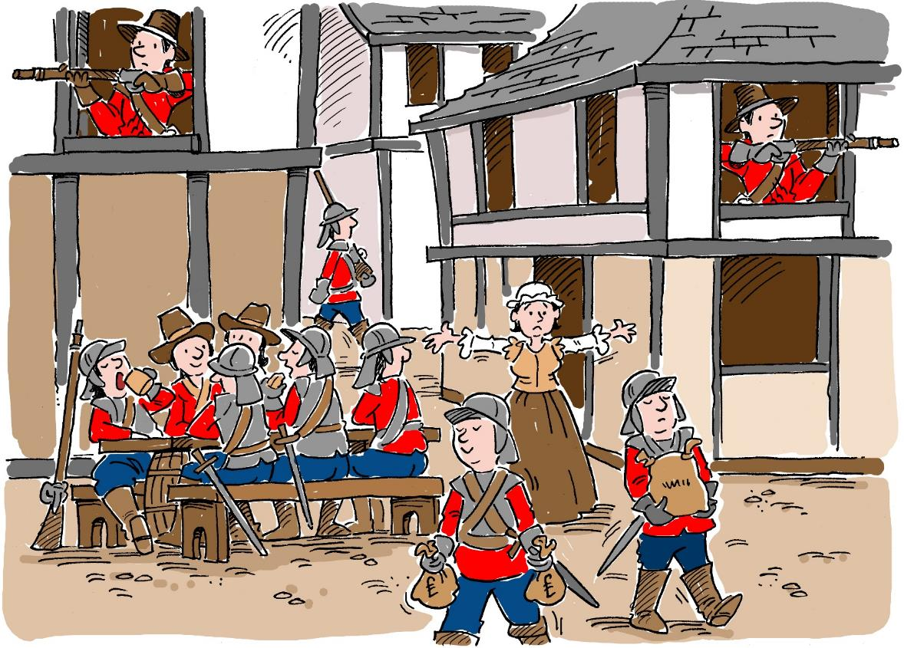
Ordinary People
The war reached towns and villages all over the country. The fighting affected everyday life everywhere.
People living near garrisons had to give the soldiers money, food and supplies, like clothes and horses.
In some places people found they had to feed and supply both sides!

Slide 43
‘ ..a ruined county.. no man has anything to call his own or assure himself a quiet night’s sleep, they are so surrounded with garrisons both of the King’s and the Parliament’s. What one leaves the other takes..
In 1644, Lincolnshire was described as
Click here to listen

